Slide 1
Course Code:CSC402A Course Title: Web Architecture and Application Development
Course Leader:
Kishore S.M.
kishore.cs.et@msruas.ac.in

Slide 2
Objectives
After completing this lecture, the student will be able to
Describe SOA and Web Services
Analyze SOA layers
Analyze networked SOA
Analyze process enabled SOA

Slide 3
Contents
SOA and Web services
SOA layers
Networked SOA
Process enabled SOA

Slide 4
SOA and Web Services
Web Services are one possible way of realizing the infrastructure aspects of SOA
Using Web Services is often recommended because it seems to be becoming established as the standard technology
Web services are self-describing and modular applications that expose business logic as services that can be published, discovered, and invoked over the Internet

Slide 5
SOA Layers
SOA layers, provide a conceptual structure at the enterprise level that organizes the application frontends and services
Each layer contains distinct types of services and application frontends
Layers
Enterprise
Process
Intermediate
Basic

Slide 6
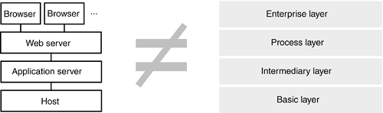
Relationship Between Traditional Tiers and SOA Layers

Slide 7
SOA Layers
Enterprise layer
The top layer of SOAs
Contains application frontends and public enterprise services, which are the end-points that provide access to the SOA
These endpoints facilitate
The communication between end users and the SOA (application frontends)
Cross-enterprise (or cross-business unit) integration (public enterprise services)
Process layer
The process layer contains process-centric services

Slide 8
SOA Layers contd.
Intermediary layer
The third layer contains intermediary services
These services act as façades, technology gateways, and adapters
An intermediary service also can be used in order to add functionality to an existing service
Basic layer
The bottom layer contains the basic services of the SOA
Represent the foundation of the SOA by providing the business logic and data

Slide 9
Expansion Stages of SOA
The expansion stages indicate the allocation of responsibility between the application frontends and the services
Fundamental SOA
Much of the complexity and responsibility is still allocated at the application frontend
Does not provide all features of a fully leveraged SOA
Networked SOA
Intermediary services aggregate low-level basic services to more sophisticated services
Process-enabled SOA
The application frontends delegate process control to the SOA

Slide 10
Fundamental SOA
A fundamental SOA consists of two layers
The basic layer
The enterprise layer
It enables two or more applications to share business-logic and live data
It provides a strong platform for large enterprise application landscapes
It enables enterprise organizations to start small on the technical side and focus on other critical success factors

Slide 11
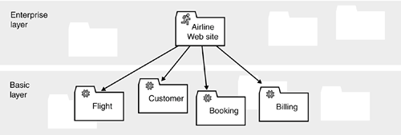
Fundamental SOA
A simple example shows how one application can be divided into meaningful components using an SOA
The Airline Web site utilizes four services that encapsulate the major business entities and their behaviors that are relevant to the business processes that are exposed to the customers

Slide 12
Main Characteristics and Scope of a Fundamental SOA
Due to its simplicity, it is technically easy to implement
A fundamental SOA increases the maintainability of an enterprise application landscape
Shared services can make data replication (enterprise application integration) largely obsolete

Slide 13
Networked SOA
It deals with backend complexity in addition to technical and conceptual integration
It includes a layer of intermediary services that can include facades, technology gateways, adapters, and functionality adding services

Slide 14
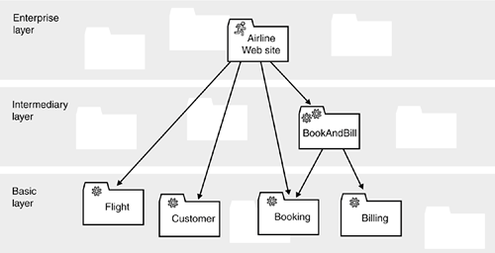
Networked SOA
The intermediary service BookAndBill encapsulates the handling of distributed transactions that span the services Booking and Billing

Slide 15
Networked SOA
Figure provides an example of the booking and the billing services that must update their databases in a coordinated manner
Depending on the detailed requirements and the concrete technology upon which the booking and the billing services are built, it is not always simple to guarantee consistency
The client developers should be shielded from this kind of complexity
If multiple clients require similar functionality, there should be no duplication of workload
In our example, this complexity is encapsulated by the intermediary service "BookAndBill."

Slide 16
Main Characteristics and Scope of a Networked SOA
Application frontends can be more lightweight when compared to a fundamental SOA
The application frontends are shielded from the complexity of backend systems
They remain complex because they must cope with the business processes
Intermediary services bridge technical and conceptual gaps
A networked SOA enables the enterprise to flexibly integrate its software assets independently of underlying technology

Slide 17
Process-Enabled SOA
The key feature of the process-enabled SOA is the maintenance of process state in process-centric services
Process-centric services are stateful
Several possible reasons for introducing a process-centric service
Encapsulating the complexity of processes
Sharing state between multiple clients
Handling long-living processes
Encapsulating process state in a process-centric service enables application frontends to be simple and lightweight and at the same time very user-friendly with an elaborate handling of the user session

Slide 18
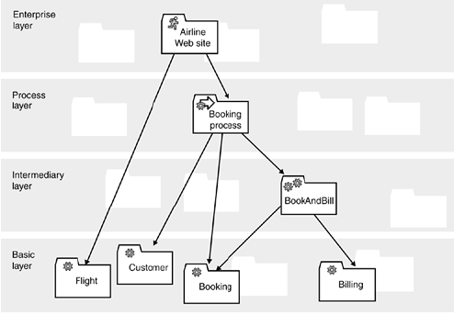
Process-Enabled SOA

Slide 19
Characteristics of a Process-Enabled SOA
Enables lightweight application frontends that "only" need to worry about user interaction
Encapsulates complexity of business processes and handles their state
Encapsulates complexity of backend systems in intermediary services and process-centric services
Represents the most sophisticated expansion stage and is therefore more difficult to implement than other expansion stages
It is required for integration of highly independent organizations and the implementation of complex processes

Slide 20
Summary
Web Services are one possible way of realizing the infrastructure aspects of SOA
Application frontends can be more lightweight when compared to a fundamental SOA
The key feature of the process-enabled SOA is the maintenance of process state in process-centric services

